Slide 1
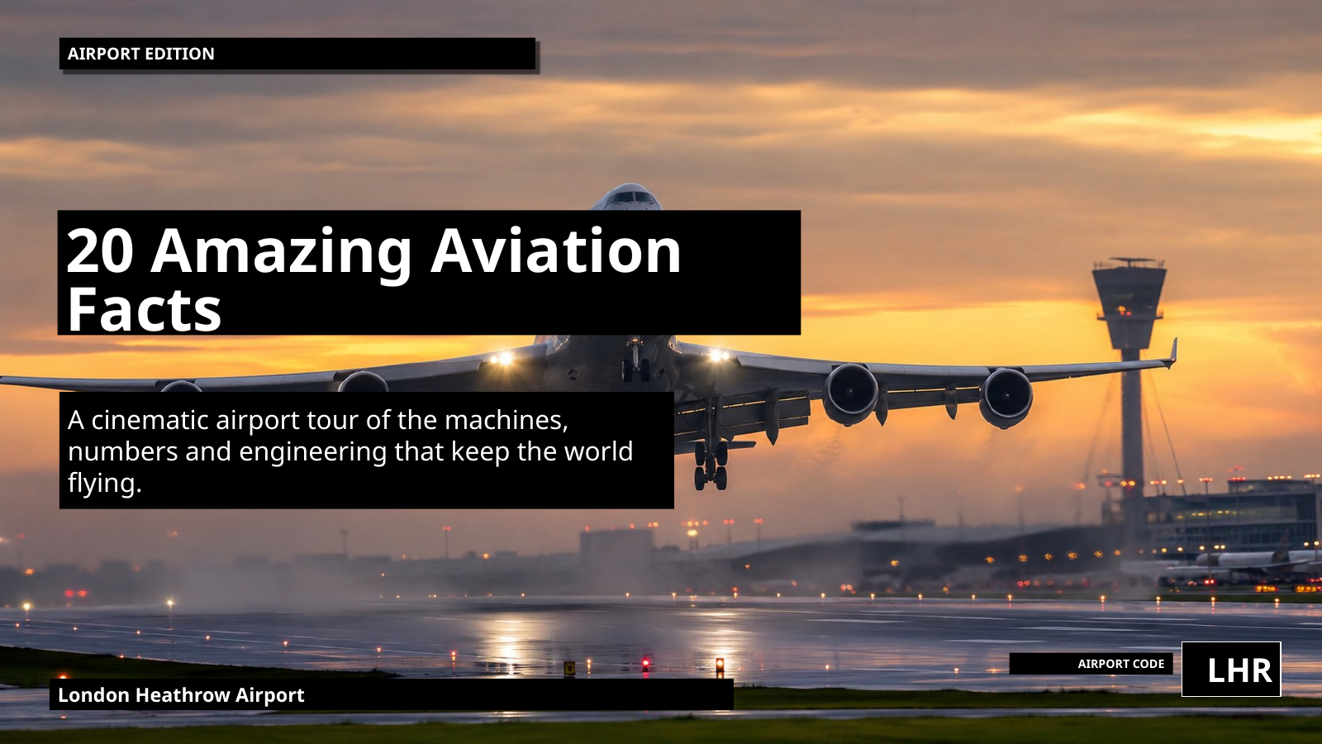
Notes:
Hi my name is Oscar Rose .
This is a fast tour of aviation: huge numbers, giant machines, and the hidden coordination that keeps the sky moving safely.

Slide 2
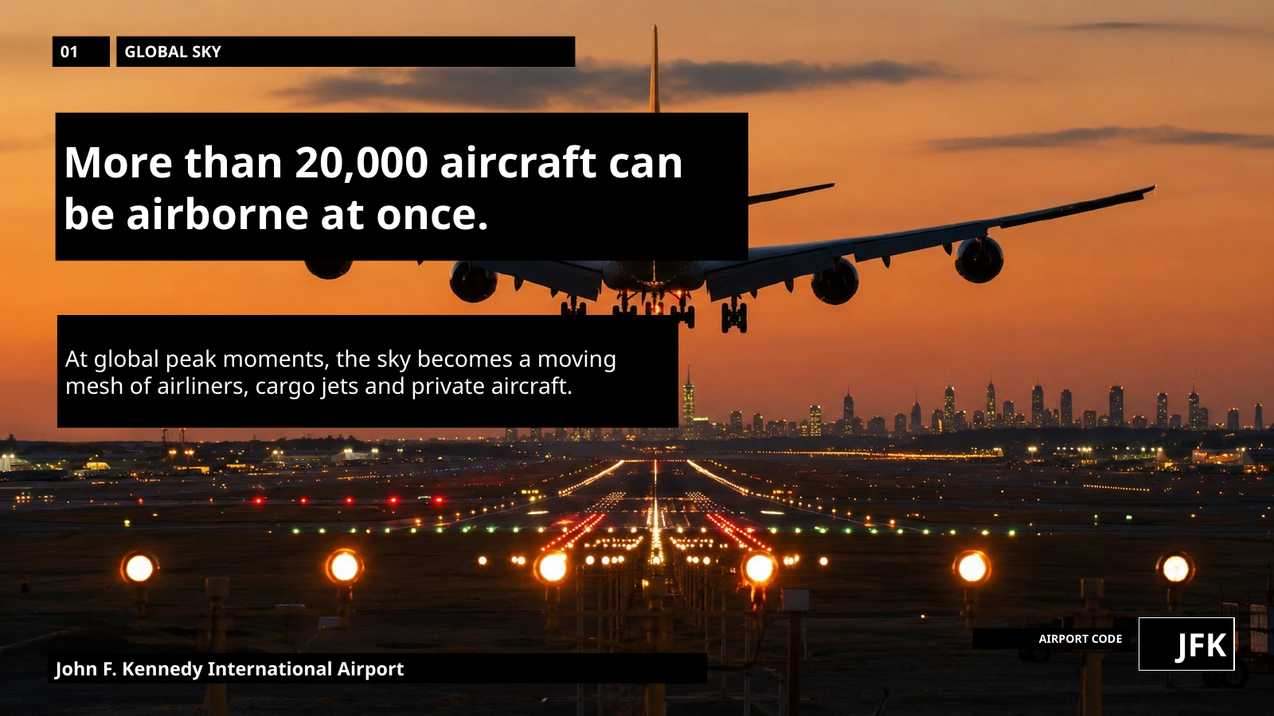
Notes:
At peak moments, more than 20,000 aircraft can be airborne at once — a live global mesh moving above us.

Slide 3
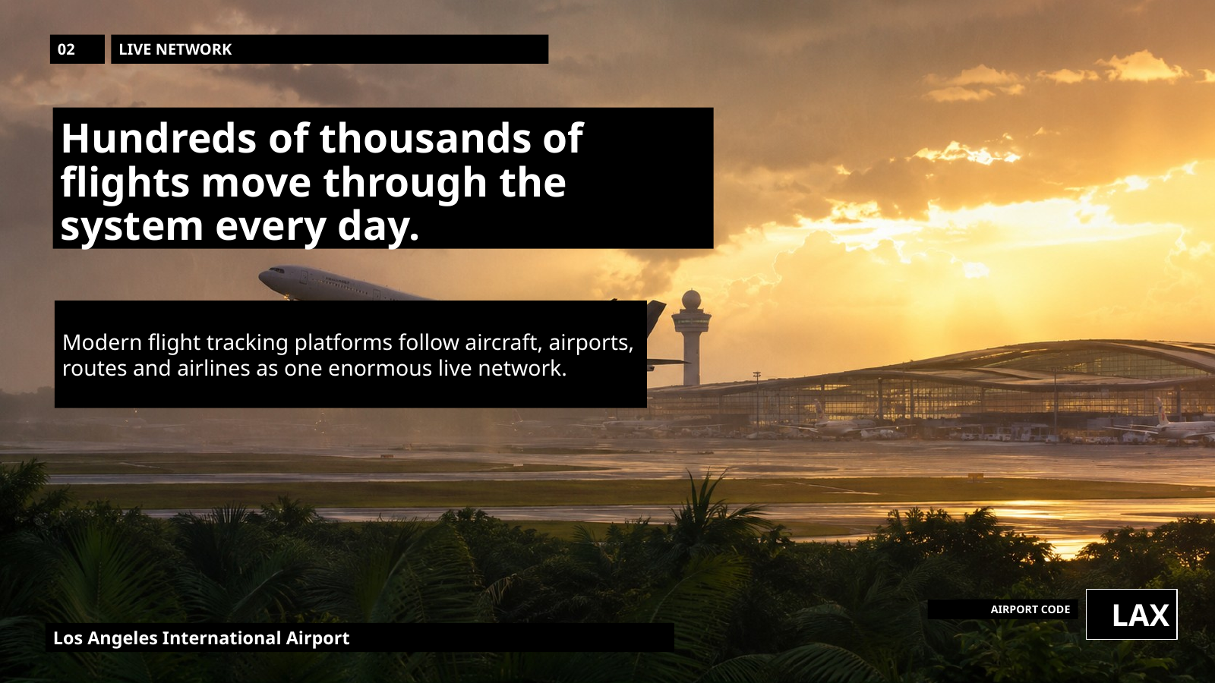
Notes:
Every day, aviation runs like a planet-wide timetable, linking aircraft, airports, crews, passengers and freight in real time.

Slide 4
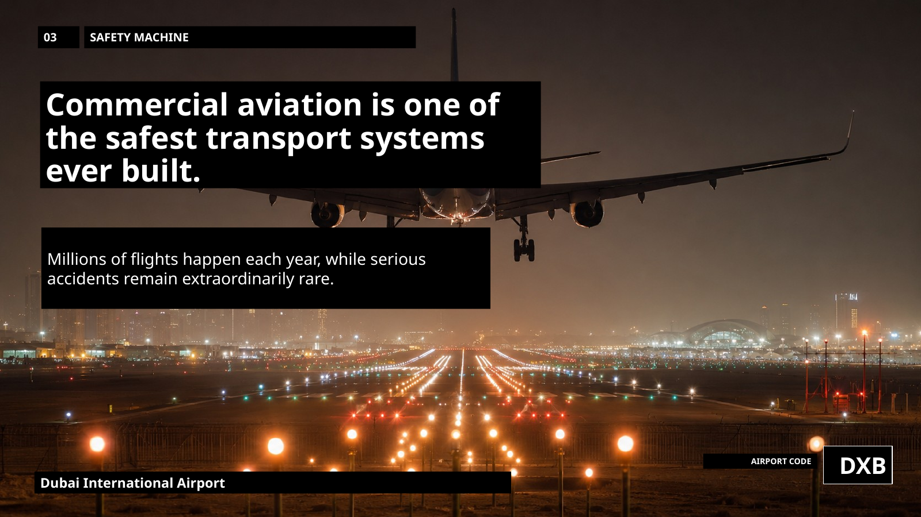
Notes:
Aviation is incredibly safe because of training, maintenance, regulation, redundancy and constant learning — not luck.

Slide 5
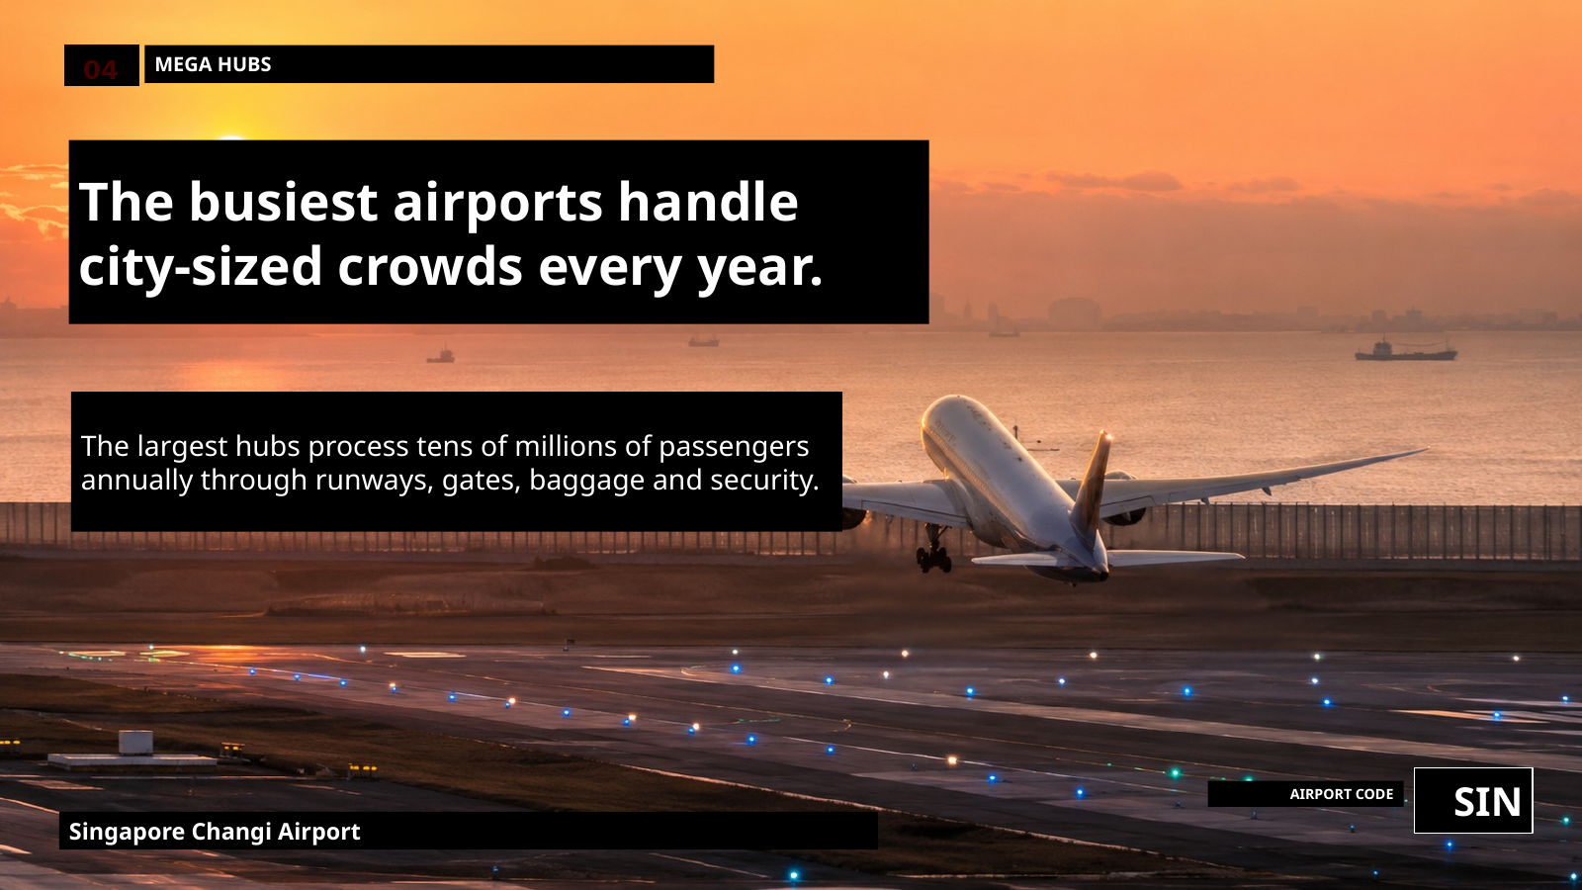
Notes:
The busiest airports handle passenger numbers the size of major cities, while moving bags, fuel, gates, crews and aircraft together.

Slide 6
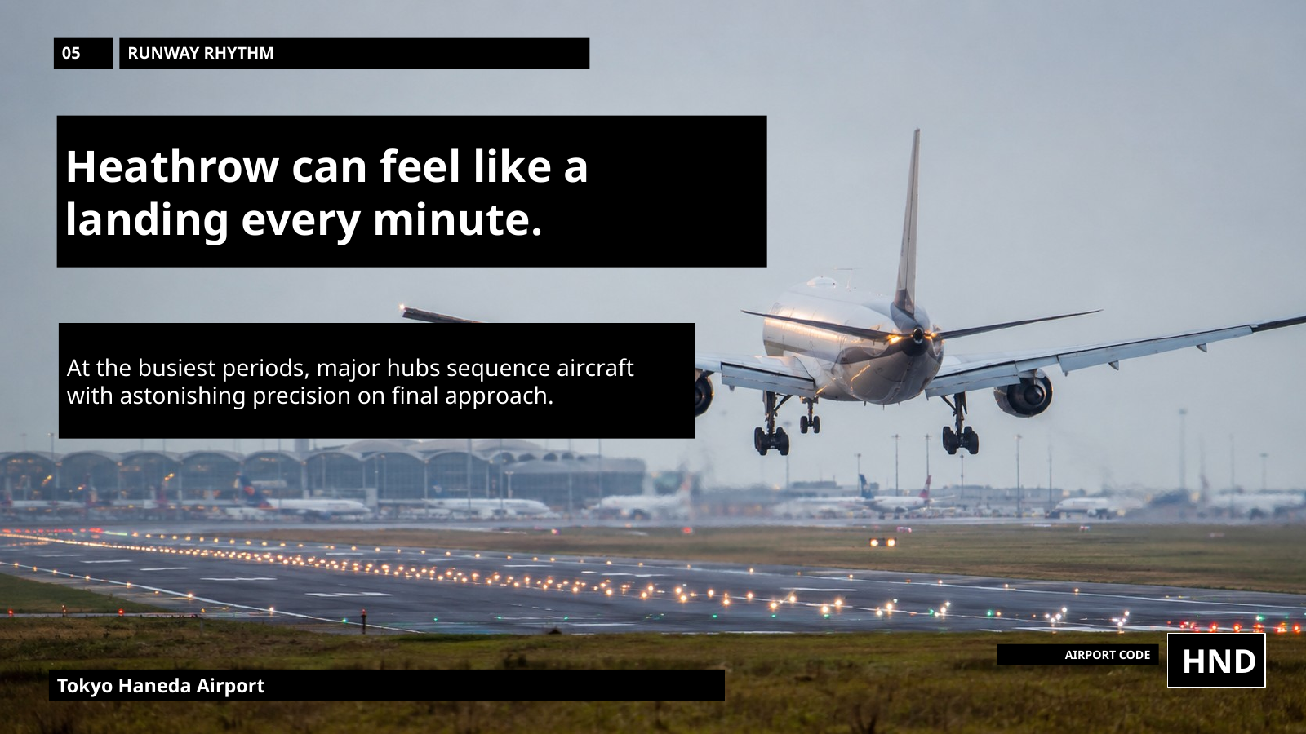
Notes:
At hubs like Heathrow, aircraft can arrive almost continuously, each landing precisely, clearing the runway, and making space for the next.

Slide 7
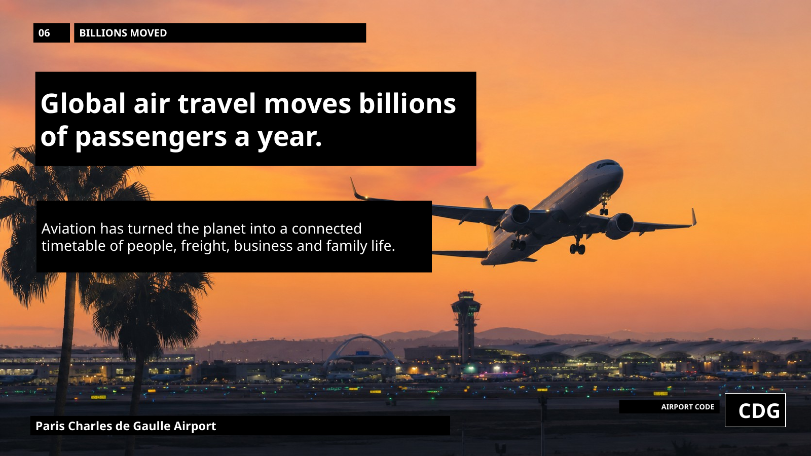
Notes:
Global aviation moves billions of passengers a year, connecting business, holidays, families, medicine and freight across the world.

Slide 8
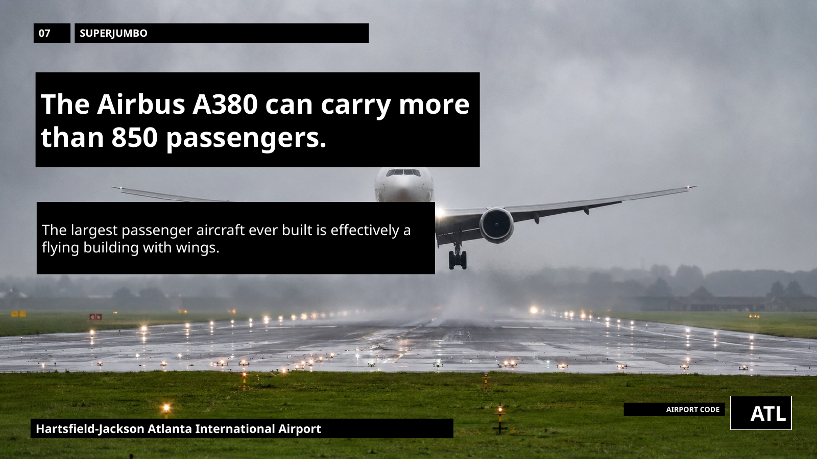
Notes:
The Airbus A380 shows the scale: in its densest layout, it can carry more than 850 people — almost a flying building.

Slide 9
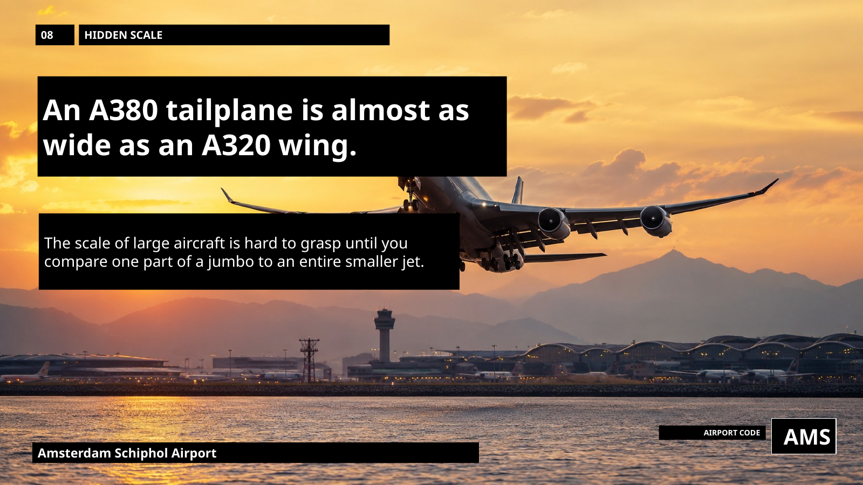
Notes:
Aircraft hide enormous engineering. Even an A380 tailplane is nearly as wide as the wing of a smaller airliner.

Slide 10
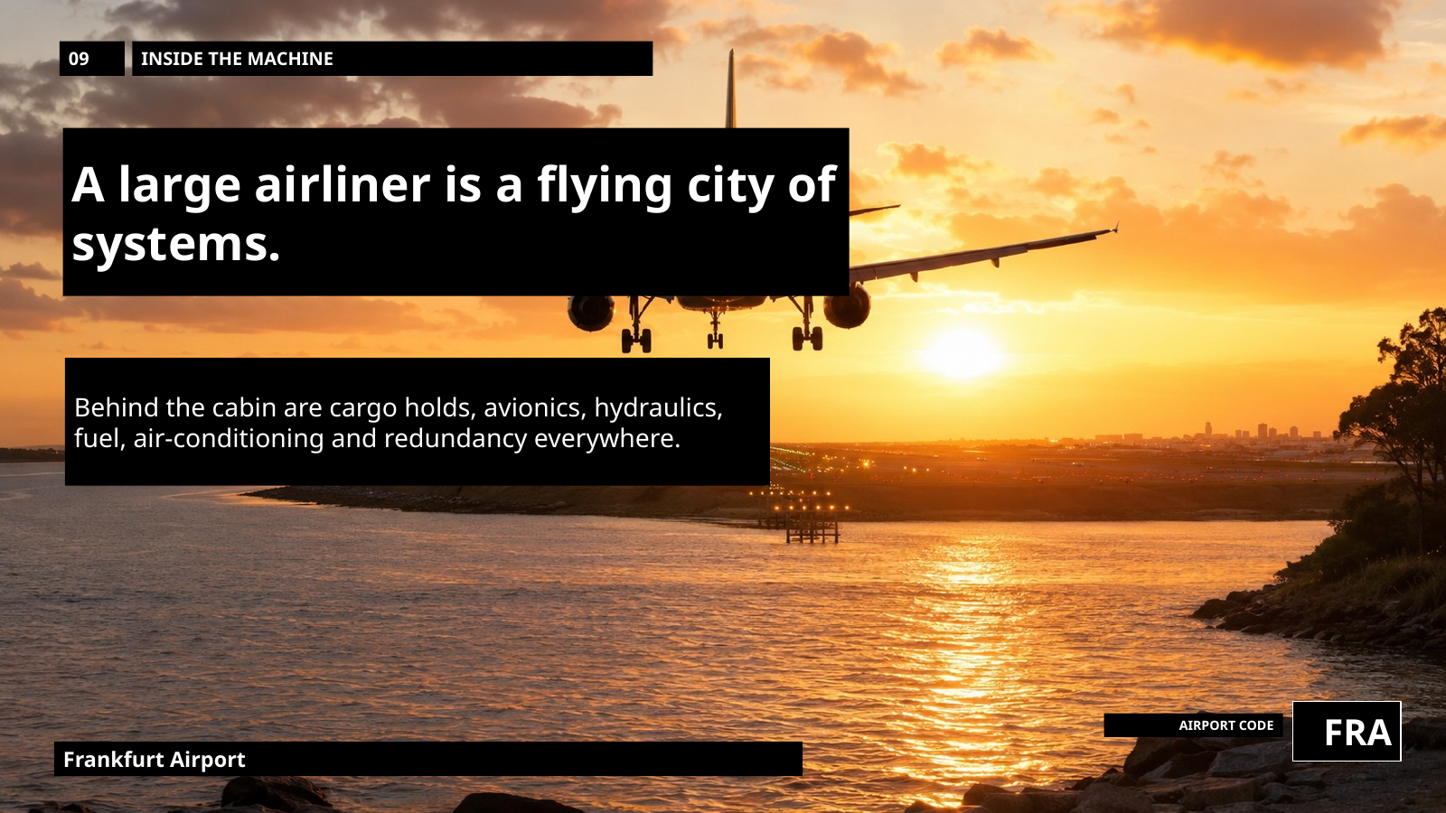
Notes:
A modern airliner is a flying system: hydraulics, electronics, fuel, air, cargo, oxygen, navigation and backups — all behind a quiet cabin.

Slide 11
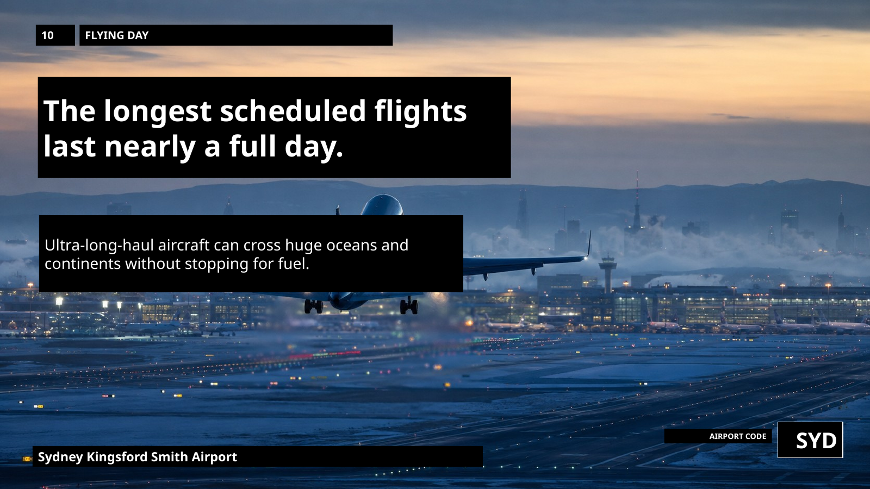
Notes:
Ultra-long-haul flights can last nearly a full day, crossing oceans and continents without stopping.

Slide 12
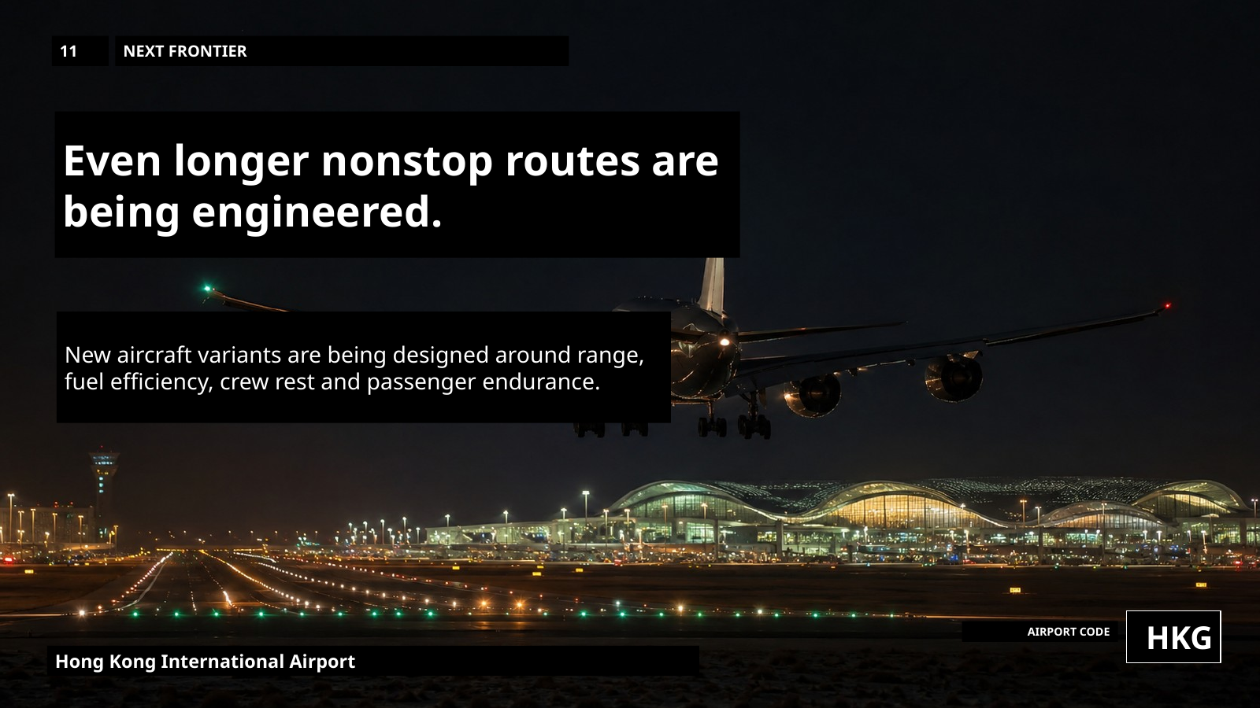
Notes:
The next frontier is even longer nonstop travel: linking distant cities directly while managing fuel, comfort, crew and safety.

Slide 13
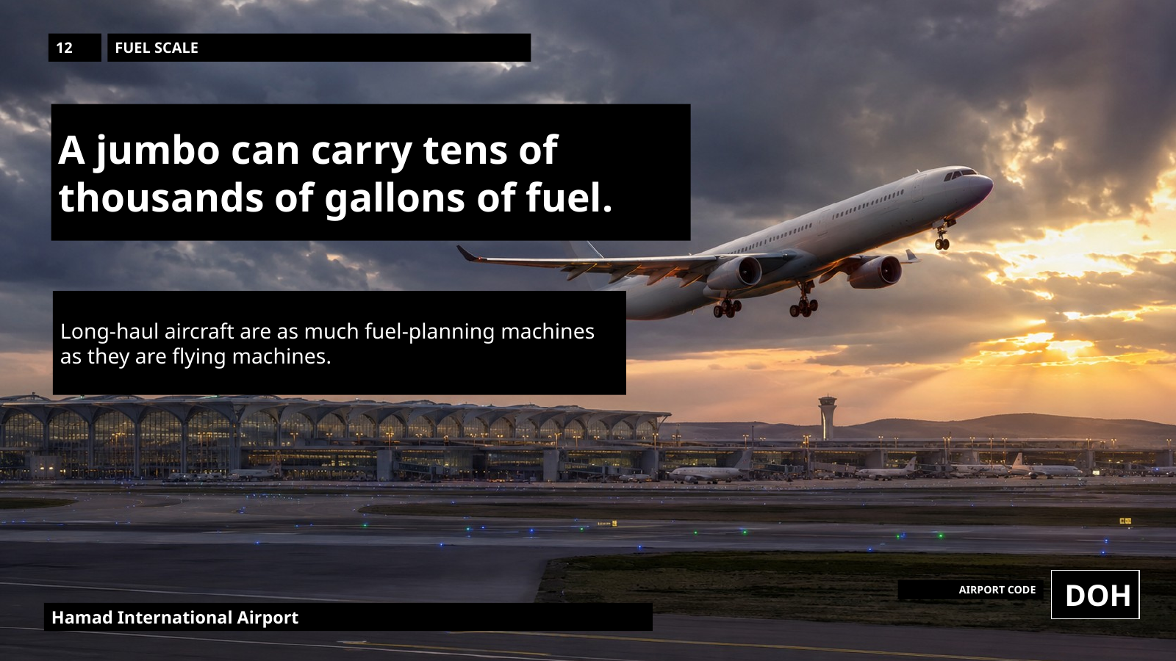
Notes:
Fuel planning is astonishing. Long-haul aircraft carry tens of thousands of gallons, carefully calculated against weather, payload and reserves.

Slide 14
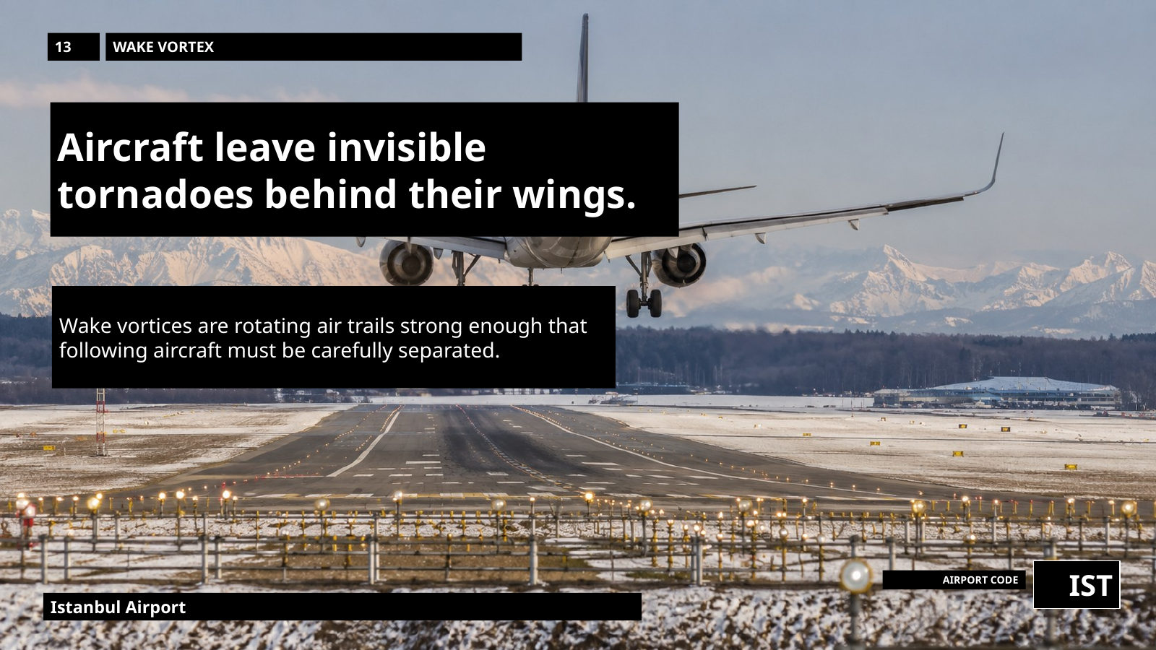
Notes:
Aircraft leave invisible wake vortices behind them — spinning trails of air strong enough to affect the next aircraft.

Slide 15
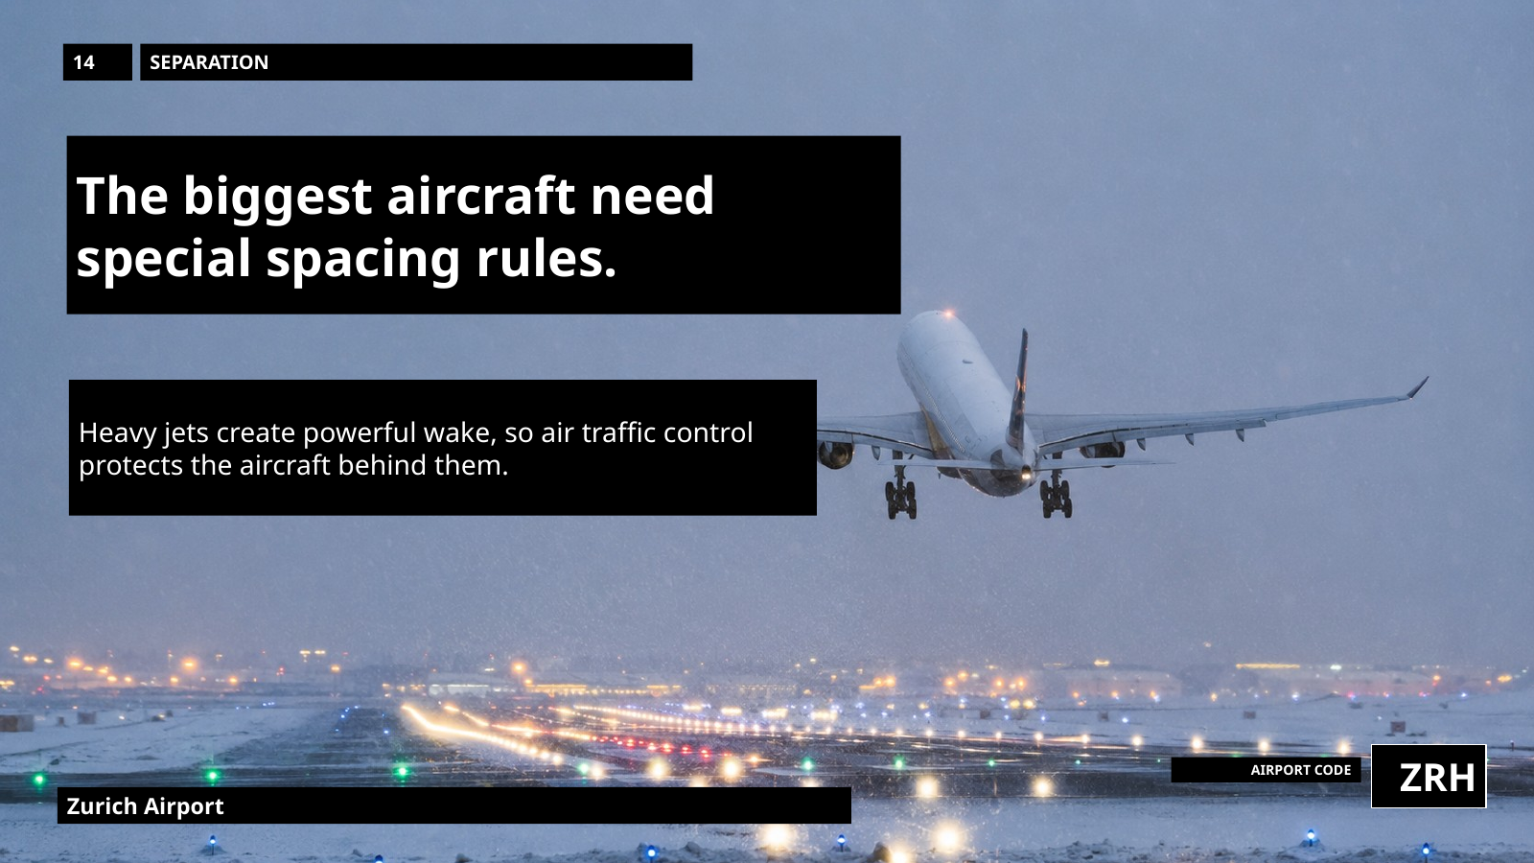
Notes:
Large aircraft need extra spacing because their wake is stronger, so air traffic control manages invisible air as well as visible aircraft.

Slide 16
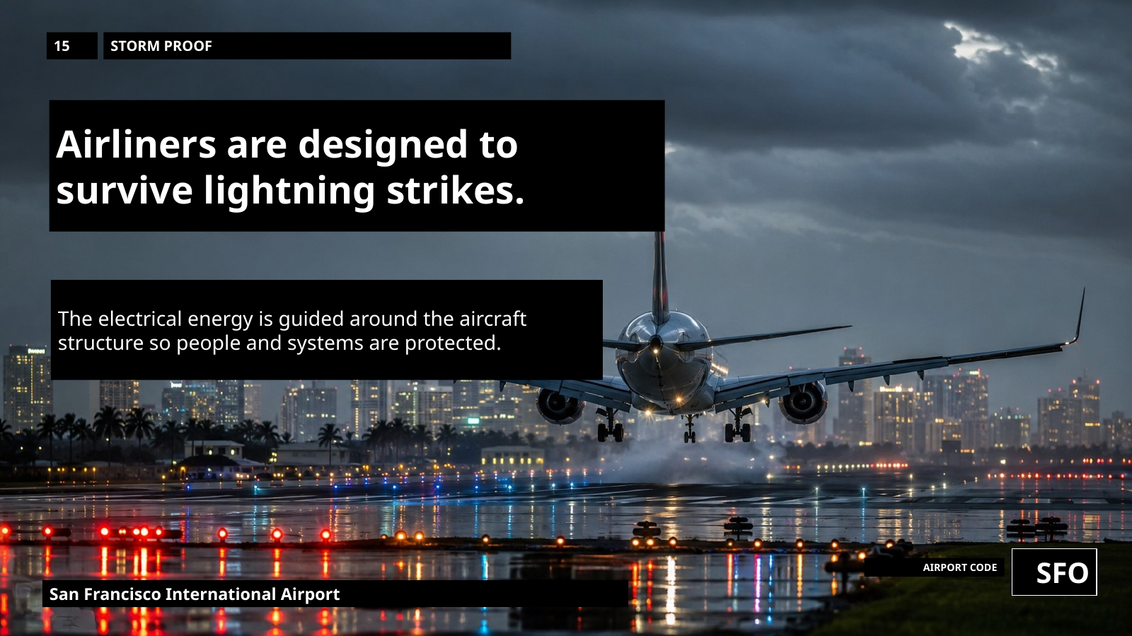
Notes:
Airliners are designed for lightning. Their structure conducts the energy around the outside, protecting the people and systems inside.

Slide 17
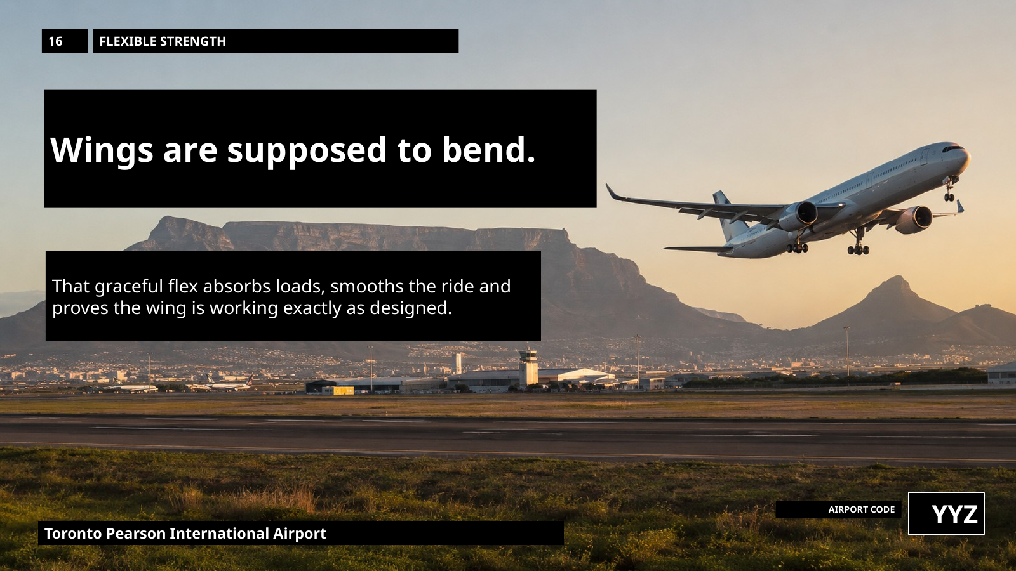
Notes:
Wings are meant to flex. That bending absorbs load, smooths the ride and shows strength, not weakness.

Slide 18
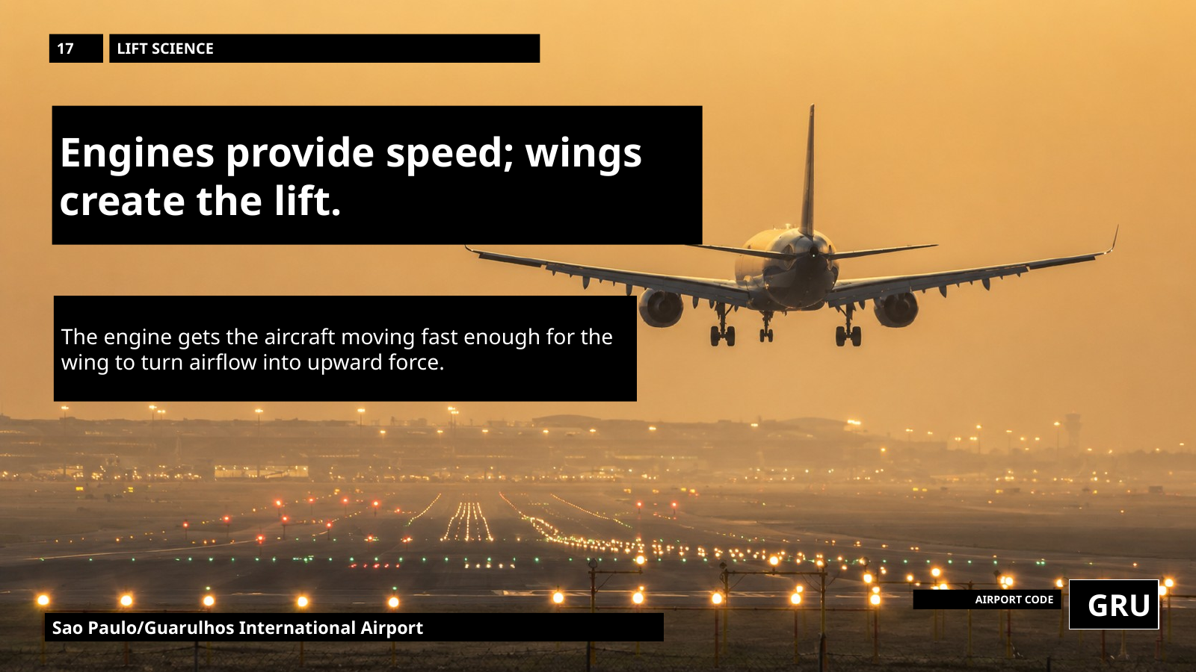
Notes:
Engines give speed, but wings create lift. Aviation turns forward motion through air into upward force.

Slide 19
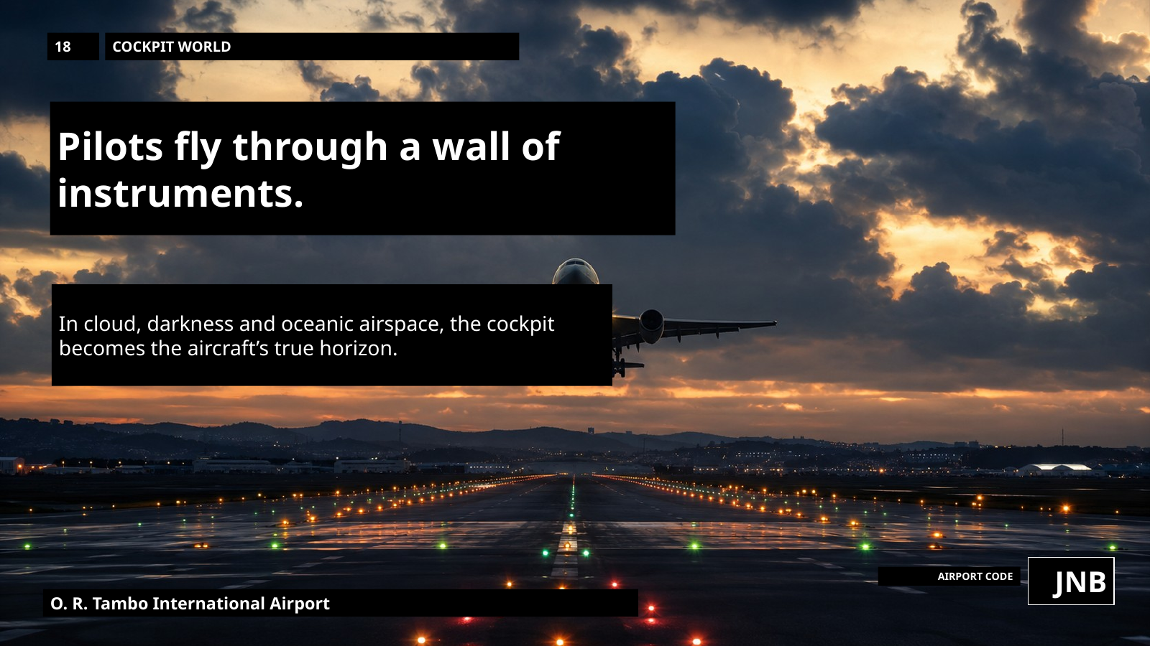
Notes:
In cloud, darkness or over the ocean, pilots rely on instruments and procedures — the cockpit becomes the true horizon.

Slide 20
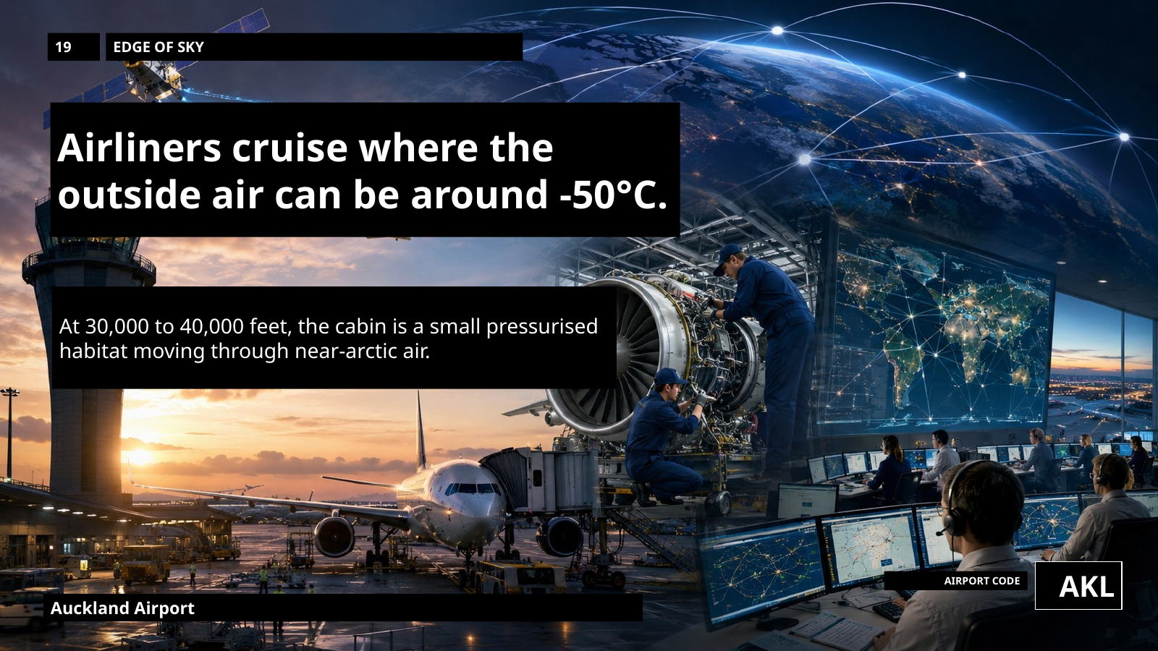
Notes:
At cruise, passengers sit in a warm pressurised cabin while outside air can be around minus 50 degrees Celsius.

Slide 21
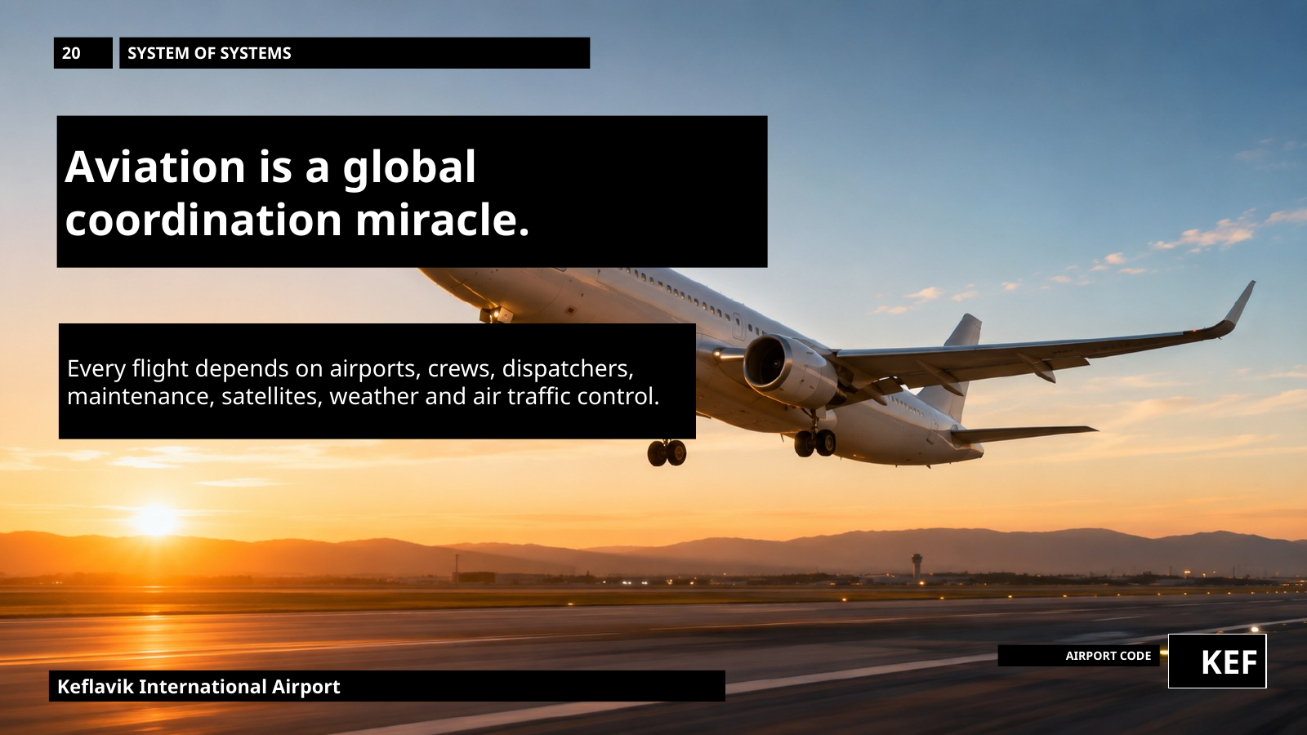
Notes:
The real miracle is coordination: crews, engineers, airports, satellites, weather systems and controllers all making aviation work every minute.
Thank you for listening to my Presentation, I will now take some questions.

